Slide 1




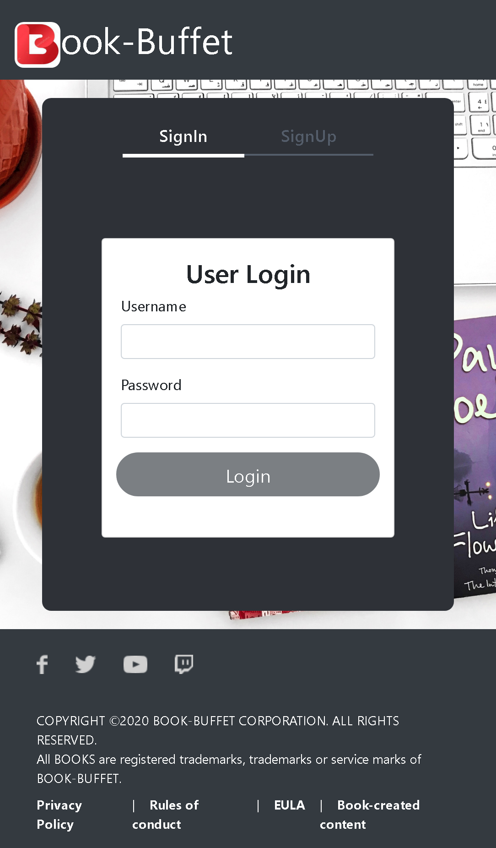
Sports Event Management System
TEAM:
Rajeeva S
Mahadevaprasad M
Prajwal H M

Slide 2

Outline
Problem Statement
Objective
Microservices
Project Overview
Onboarding-Architecture
Project Flow
Technology and Tools Used
Conclusion

Slide 3

Problem Statement
Sports Event Management Portal that manages the creation and management of a sports event. It makes it easier to maintain the different aspects of a sports event.

Slide 4






Technologies and Tools Used

Slide 5
Objectives
These Microservices performs following operations
Sports event : View all the sports by name, create and cancel the events and view all the events.
Player : Add ,Remove and view the player lists.
Participation : Request for the participation for particular event and view the request,
update the participation status as per requirements and list it by the approved
/decline status of the participation.
Authorization : Used with anonymous access to generate JWT

Slide 6
MICROSERVICES
Sports
Player
Participation
Authorization

Slide 7
Project Overview

Slide 8
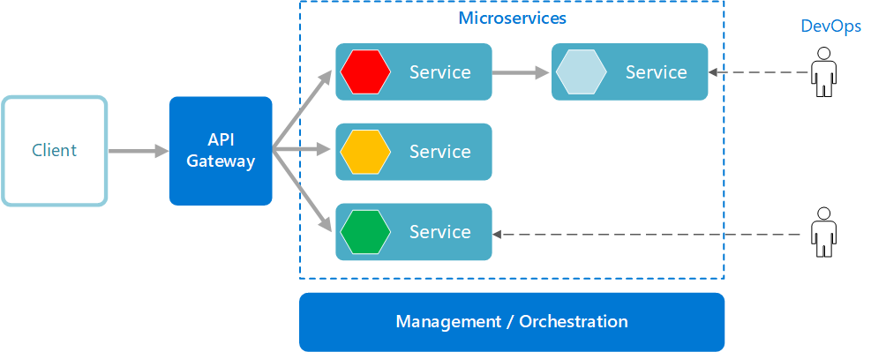
Project Overview

Slide 9
Onboarding Architecture

Slide 10
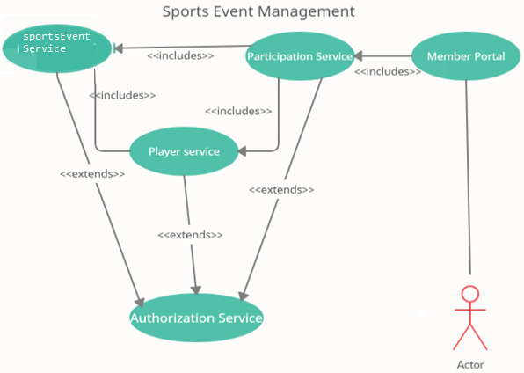
Architecture

Slide 11
Project Flow

Slide 12

Project Flow
Home
Home
Login
Register
Login
Register
Sports Event
Player
Participation
View all the Sports
View by Name
Create Update and Cancel Event
Search by id/name
Player Details
Remove player by id and view all players
Request for participation and view the request
Update participation and list it by the request
Logout

Slide 13




Challenges Faced
Integration
Working Virtually
Learning new Technologies
Debugging errors

Slide 14
Conclusion
The project is a Sports Event Management Portal that manages the creation and management of a sports event.
It makes it easier to maintain the different aspects of a sports event. The portal provides various functionalities like creating events for various sports, request for participation, etc.

Slide 15
Thank You

